Slide 1
Maths Trivia
Maths Society, IIT Delhi
12th August 2026

Slide 2
The Infinity Symbol
∞
LEMNISCATE

Slide 3
Less and Greater than Signs
< >
GUILLEMETS
Pronounced as Geemos

Slide 4
Question Mark
?
EROTEME

Slide 5
Factorial Sign
!
ECPHONESIS OR ECPHONEME

Slide 6
Amblygon angle Am obtuse angle
Oxygon angle Am Acute angle

Slide 7
2 sides of a right angle Triangle
CATHETUS

Slide 8
Q is set of Rational Numbers
Why ?
How are Irrational Numbers represented ?
Why ℤ is used for set of Integers ?

Slide 9
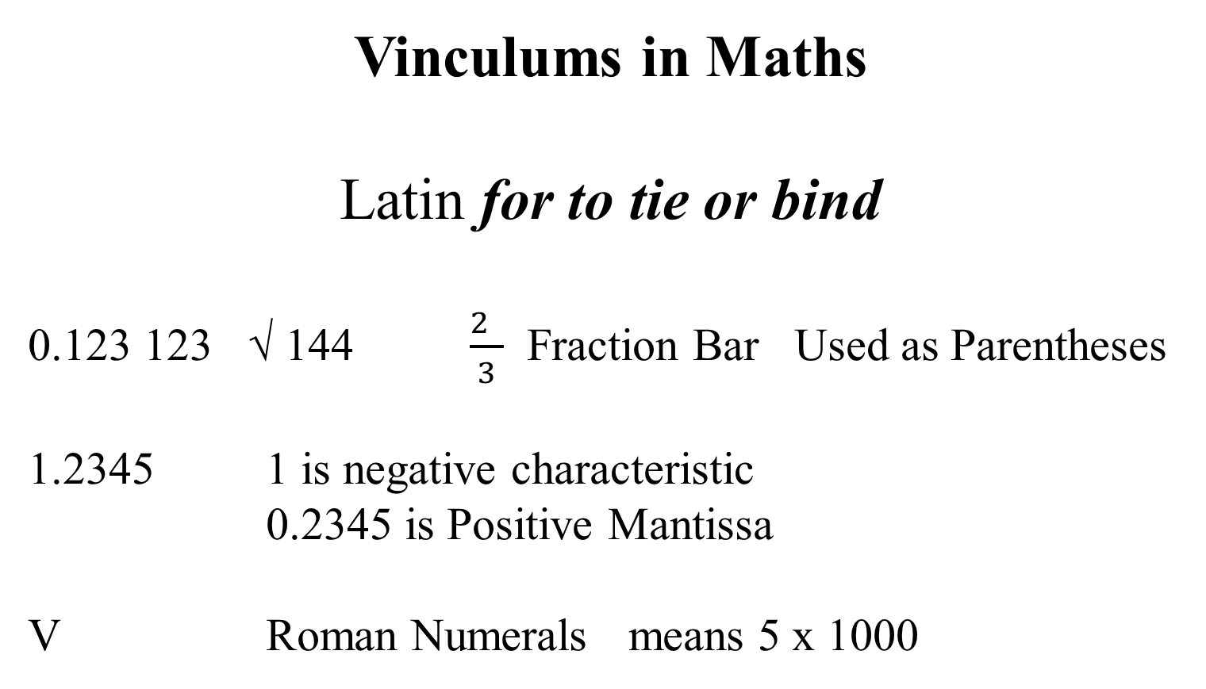
Vinculums in Maths
Latin for to tie or bind
0.123 123 √ 144 $\frac{2 }{3}$ Fraction Bar Used as Parentheses
1.2345 1 is negative characteristic
0.2345 is Positive Mantissa
V Roman Numerals means 5 x 1000

Slide 10
Vinculums, Vedic Maths and Modern Day Logarithms
2 ÷ 3
= Log 2 minus Log 3
= 0.3010 – 0.4771 Use Smart Subtraction
= - 0.1761 Both Charateristic n Mantissa are Negative
= - 1.0000 + 1.0000 – 0.1761 Add +1.0000 and – 1.0000
= 1 . 8239 Use Base Method Subtraction for error free Calculation

Slide 11
Addition
+ sign is called St Andrew’s Cross
1+2+3 are Addends
1 alone is an Augend

Slide 12
Subtraction
sign is called Middle Hyphen
5 – 2
5 is Minuend
2 is Subtrahend

Slide 13
Multiplication
X sign is called Saltire

Slide 14
Division
÷ sign is called Obelus
/ is Virgule or Solidus

Slide 15
Double Tilde
≈

Slide 16
Latin Long S
∫
Short for Summa (tion)

Slide 17
How are Radians written in Maths ?

Slide 18
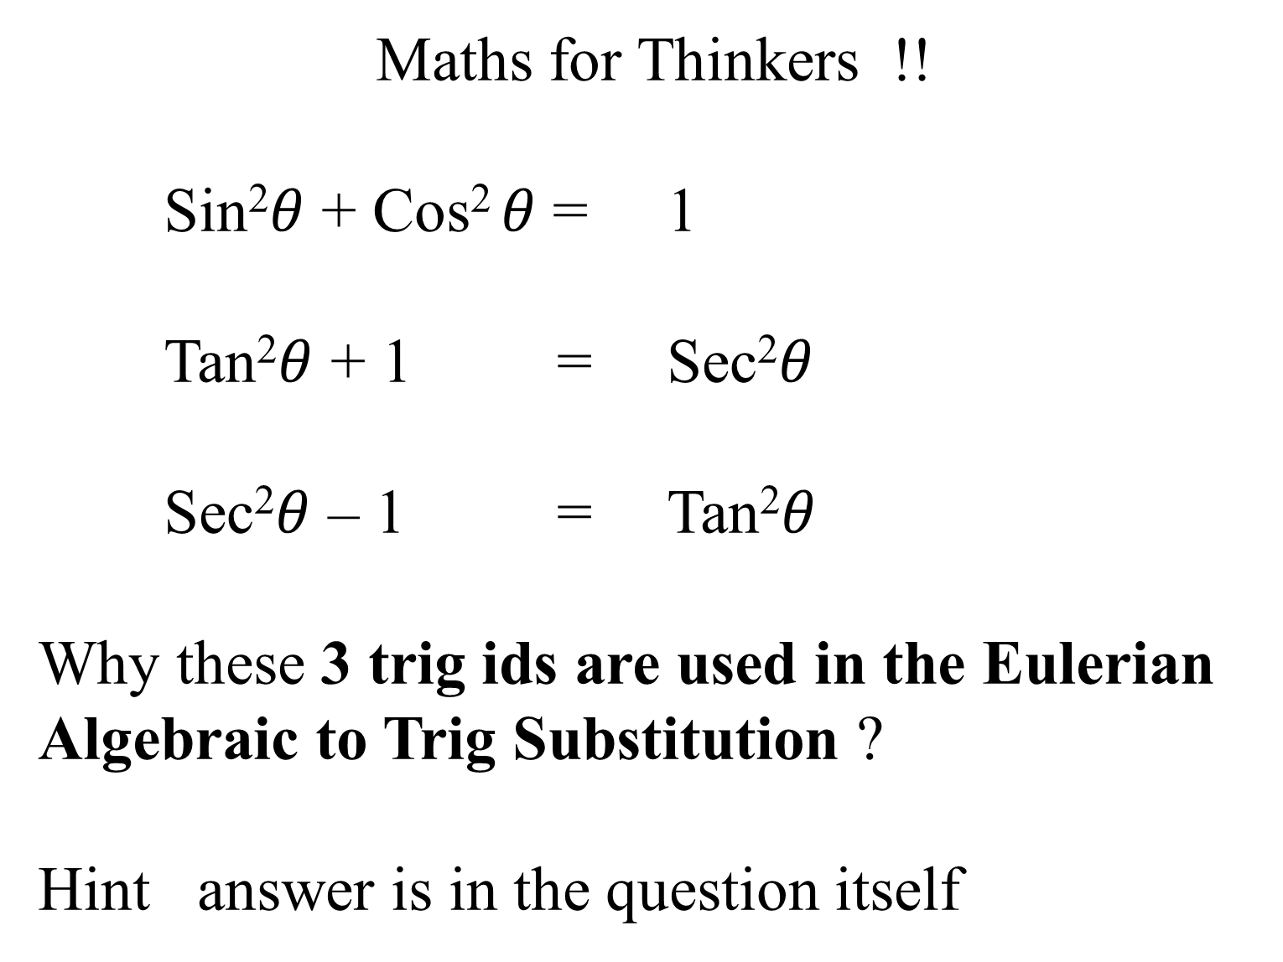
Maths for Thinkers !!
Sin²$θ$ + Cos² $θ$ = 1
Tan²$θ$ + 1 = Sec²$θ$
Sec²$θ$ – 1 = Tan²$θ$
Why these 3 trig ids are used in the Eulerian Algebraic to Trig Substitution ?
Hint answer is in the question itself

Slide 19
Maths for Thinkers !!
Compute Sine 1◦
Using Class 11 Trig and Algebra
Class 8 Geometry and Class 12 Integral Calculus

Slide 20
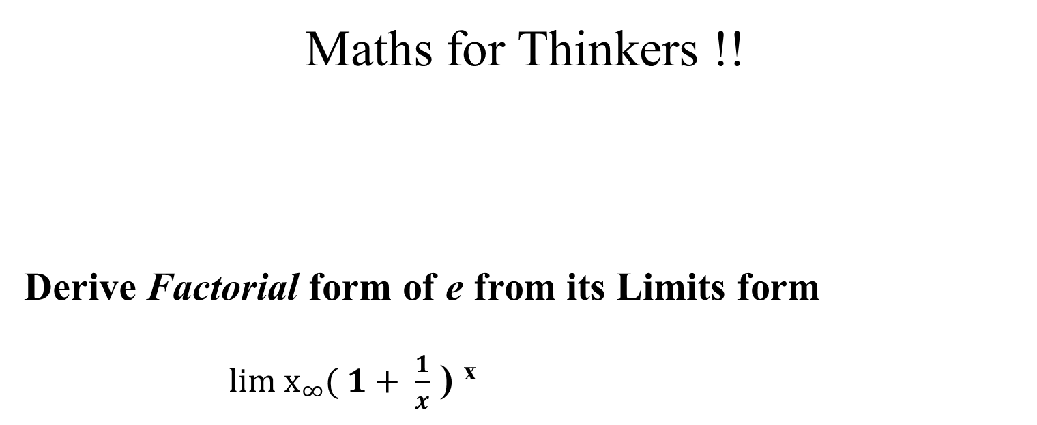
Maths for Thinkers !!
Derive Factorial form of e from its Limits form
$\underset{∞}{lim x}{( 1+ \frac{1}{x}}$ ) ^{x}

Slide 21
Maths for Thinkers !!
Which is greater ? e^{π} or π^{e}
Answer it as per a wall street bank interview question
Use Integral Calculus

Slide 22

Thank You
Vishal Bhatia
87 99 7444 90

